Slide 1


Web Application For Tutor Find Management System
SmartTutors
Course Code
Course
Proposal Presentation Date
CSE47.1
Software Development and Project Management Lab
08 Dec 2024

Slide 2

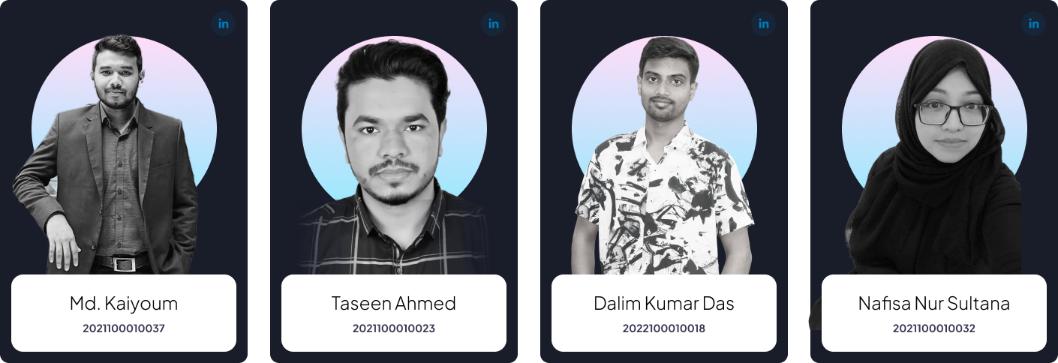

Meet Our Team Members

Slide 3

Problem Statement
In today's fast-paced world, students and learners of all ages frequently struggle to locate dependable, experienced teachers to fulfill their unique learning requirements. Current platforms are either extremely general, lack personalization, or have high pricing and limited accessibility, making it difficult for students to meet their academic or skill-building objectives.
It was so hard to find a tuition in the desired requirements.
It was not possible to get tuition for a new tutor.
In this system, people get his/her current tuition condition also advice. It saves our valuable time and consumes cost at a time.

Slide 4

Expectations from your system
After analyzing the current system and identifying its limitations, the researcher proposed creating an innovative, efficient, and effective system to apply the advance search and connection policy. The system is fairly simple to design and implement. The system takes extremely few system resources and will function in practically any arrangement. It has the following features:
Ensure data accuracy.
Records are efficiently maintained by DBMS.
Better Service.
Minimum time required.

Slide 5

Workflow for SmartTutors
Research and requirements collection
Research and requirement gathering are the first steps in the process, during which we will interact with students to learn about their difficulties entering game zones and pinpoint their most important requirements.
Creating the user interface design
Ensuring inclusivity and simplicity to make the system user-friendly for all.
Development
After that, we proceed to development, where the reservation system will be constructed. While the backend will handle the reservation process and safely store booking data, the frontend will guarantee a seamless user experience.

Slide 6
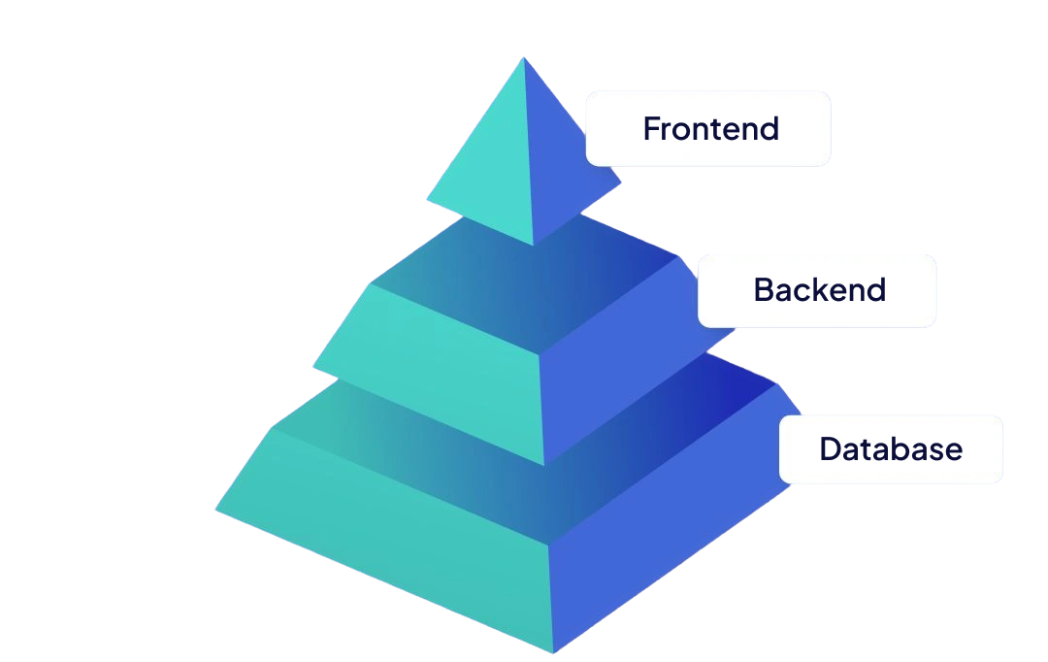
Technical Details
Frontend
HTML and CSS: For the web pages' layout, style, and design, make sure the information is arranged properly.
Bootstrap: A front-end framework that makes it simple and quick to develop mobile-first, responsive pages.
Backend
Python: To maintain the server-side scripting language that handles user requests, Registrations, and database interactions we are using Python
Datebase
SQLite: The database management system to store tutor details, registration information, and availability information.

Slide 7

Thank You From
SmartTutors
Let Me Know If You Have Any Questions

